Slide 1

Hyperparameter tuning in machine learning
Presented by :-
Hrishikesh Deshpande
ADS

Slide 2
What is Hyperparameter tuning?
This is the process of determining the right combination of hyperparameters that allows model to increase performance and predictions. By using this tuning we can enhance our accuracy of model.
There are methods like passing one by one parameters, but it is time consuming , high computation and execution rate also.
To overcome this and to maximize model performance we use Hyperparamter tuning.
To get / extract max performance of model we have to set the right combination of parameters.

Slide 3
Techniques of Hyperparamter Tuning :
1. Grid Search
2. Random Search
In these techniques instead of using one by one parameters we set parameters at a time. So, computation time decreases and accuracy increases.

Slide 4
Grid Search Technique :
Here, we provide some set of parameters and it will make all the combinations and it will check for each and every set like matrix and after that it will give the results.
Basically, we try every combination of a set of values of the hyper-parameters and evaluate the model for each combination. Each set is taken into consideration and accuracy also will get noted.
Once all the combinations are evaluated, the model with the set of parameters which give the top accuracy is considered to be the best.
But, this way this process is time taking and consuming , computationally expensive.
To overcome this we use Random Search technique.

Slide 5
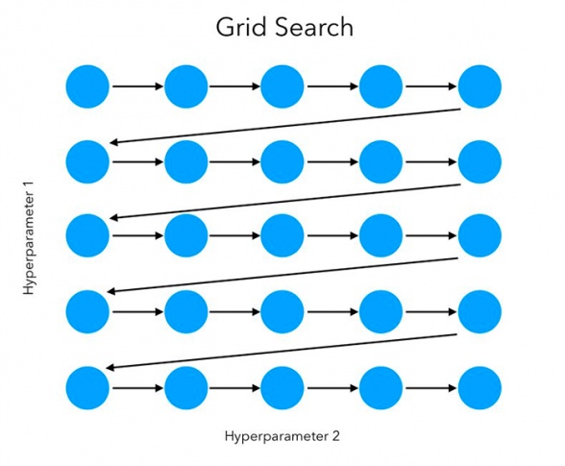
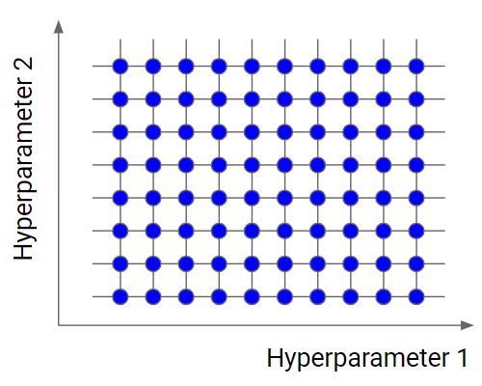

Slide 6
Disadvantages of Grid Search:
It is very slow.
Checking every combination of the space requires a lot of time.
In every point in the grid needs k-fold cross-validation, which requires k training steps. So, tuning the hyperparameters of a model in this way can be quite complex and expensive.
If we pass multiple parameter then size of grid will increase, iteration will increase and it will be very time consuming process.
Very high computation time.

Slide 7
Random Search Technique :
Random search is a technique where random combinations of hyperparamters are used to find the best solutions for our model.
Instead of checking for each and every combination it selects some random combinations or hyperparameters and it checks for those values only.
So, it gives good results, process is also fast.
It can also use for multiple hyperparameters at a time randomly and gives best accuracy. Then, model will give good result.

Slide 8
